Slide 1
HDAT9700: Presenting and summarising model results
Dr Md Shajedur Rahman Shawon
CBDRH, UNSW Sydney

Slide 2
Learning outcomes
Evaluate characteristics of good figures and tables
Understand how to report statistical significance by interpreting P-values and confidence intervals
Communicate the estimates for measures of association
Identify key guidelines and checklists for reporting of statistics

Slide 3
Housekeeping
No formal assignment for this chapter
10% marks for your final report will be based on presentation
Pre-readings:
Kenneth Rothman Six Persistent Research Misconceptions J Gen Intern Med. 2014 Jul; 29(7): 1060–1064
Professor Gary King’s video on Presenting and Interpreting Statistical Results [Available on YouTube]

Slide 4
Health data scientists
Our main tasks:
Data cleaning and management
Data analysis
Finding the perfect (!) model that explains our data

Slide 5
Then why bother about data presentation?

Slide 6
Why focusing on presenting and summarising results?
Readers of our research are humans (busy + inattentive + lazy to some extent)
First chance to create impressions of your work
The probability of your research having an impact
Meeting scientific standards
More importantly, scientific communication is an important part of science

Slide 7
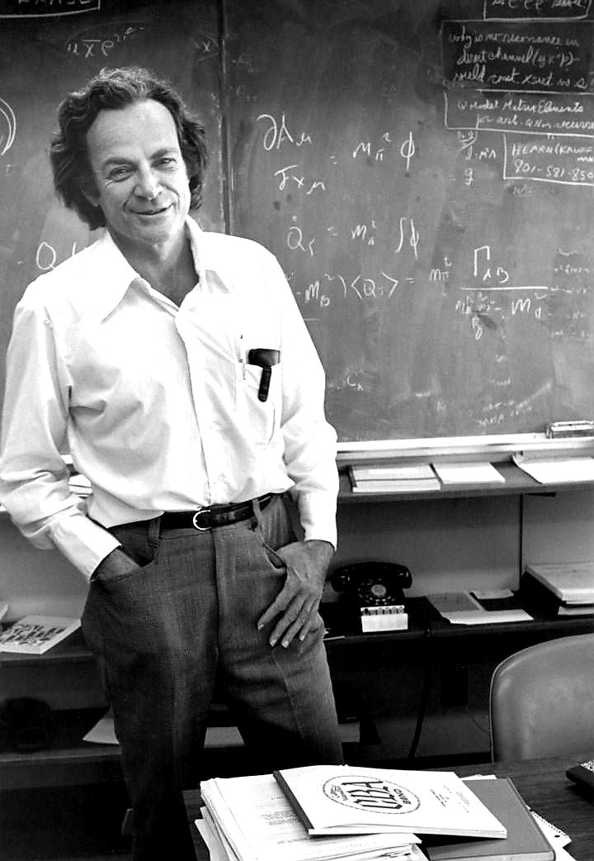
My favourite science communicator

Slide 8


Slide 9
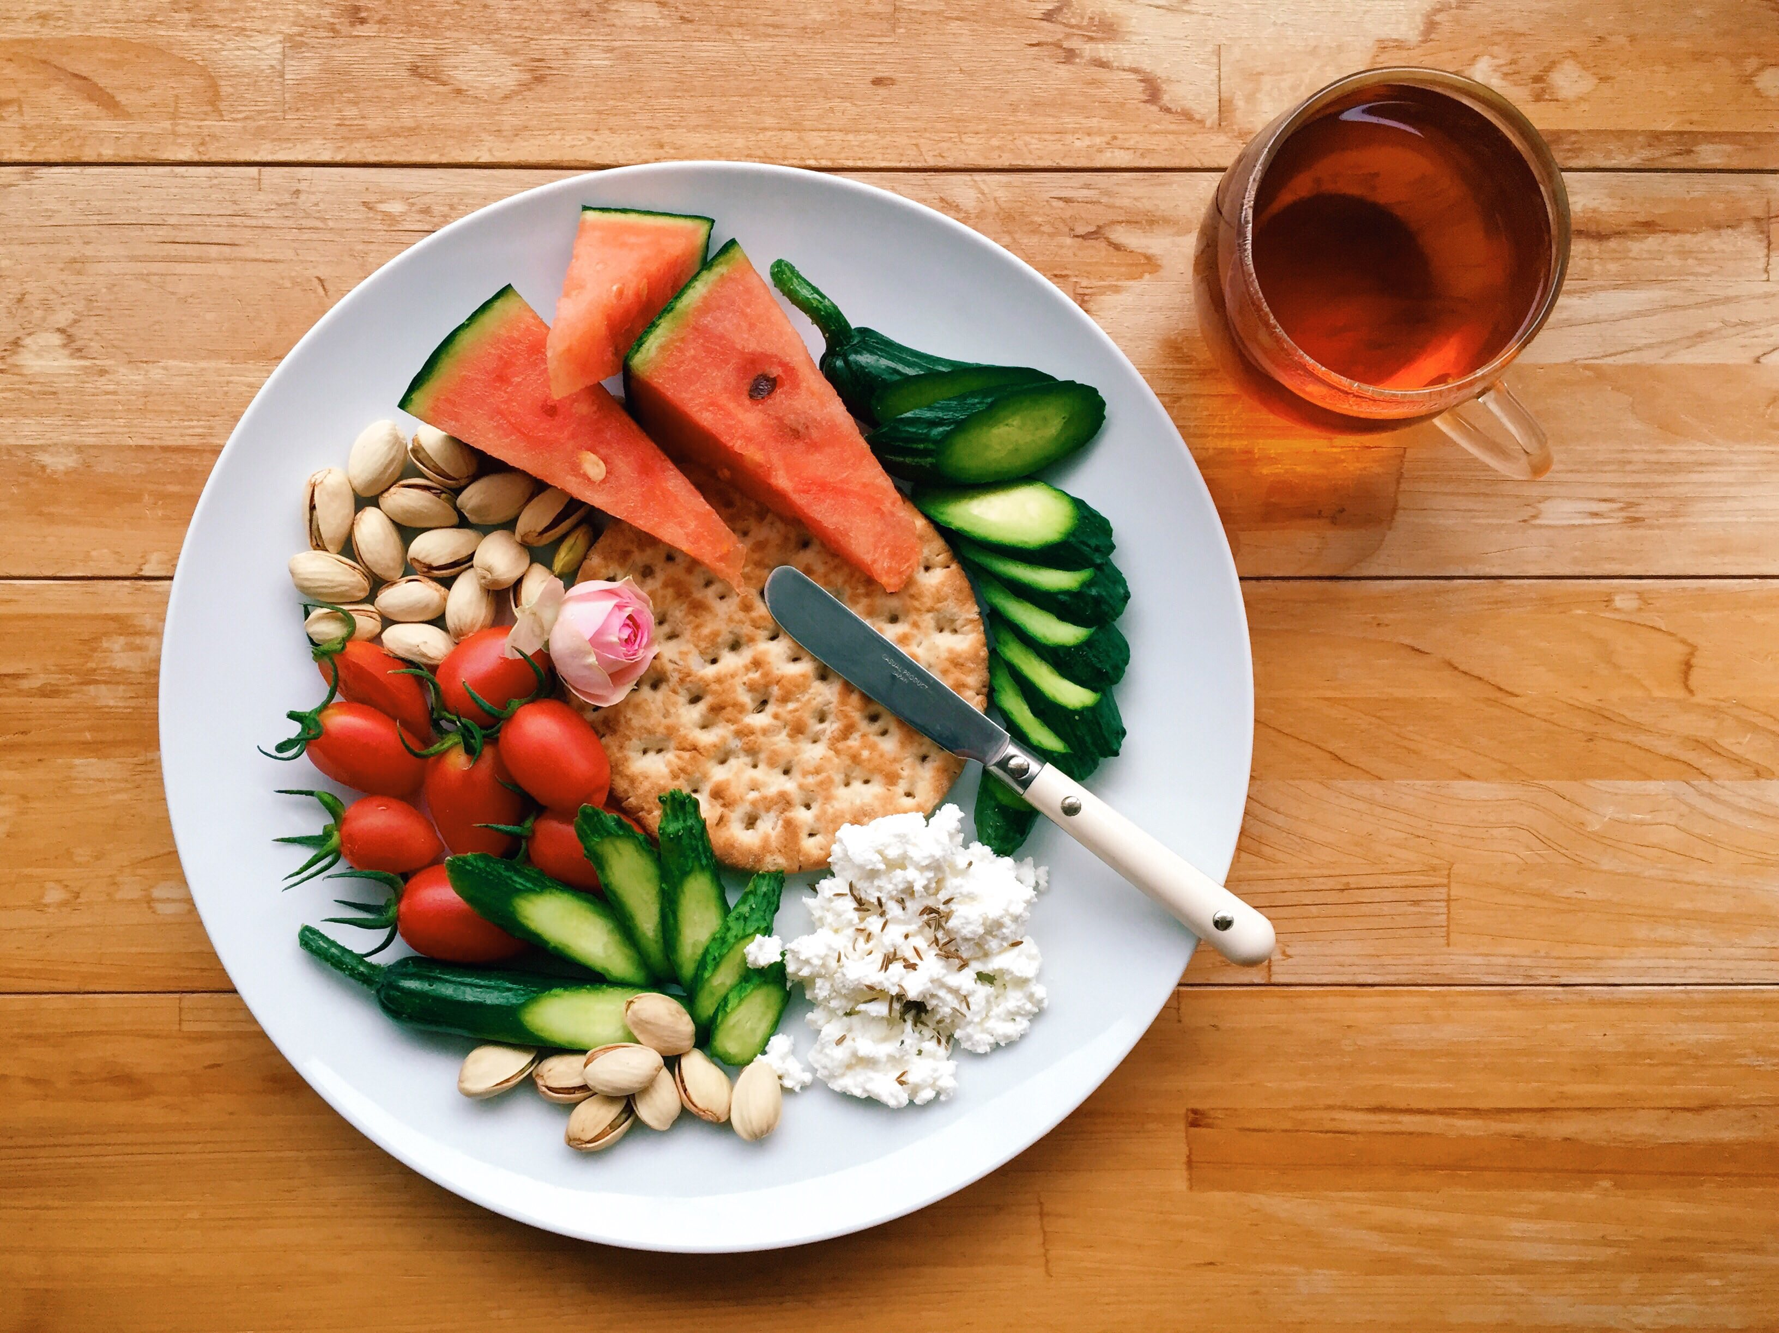

Slide 10
What are the ways to present results?

Slide 11
Model results can be presented as
Table
Figure
Text

Slide 12
Tables vs. Figures
Tables and figures are the backbones of almost all scientific documents.
Readers often look at them first, even before reading any text
Figures are helpful because
Figures have a strong visual impact
Figures are used to show trends and patterns in data
Figures can be used to highlight the most important results
Tables can be helpful because
Tables can give precise values
We can display a lot of information (many variables with many values) in a table

Slide 13
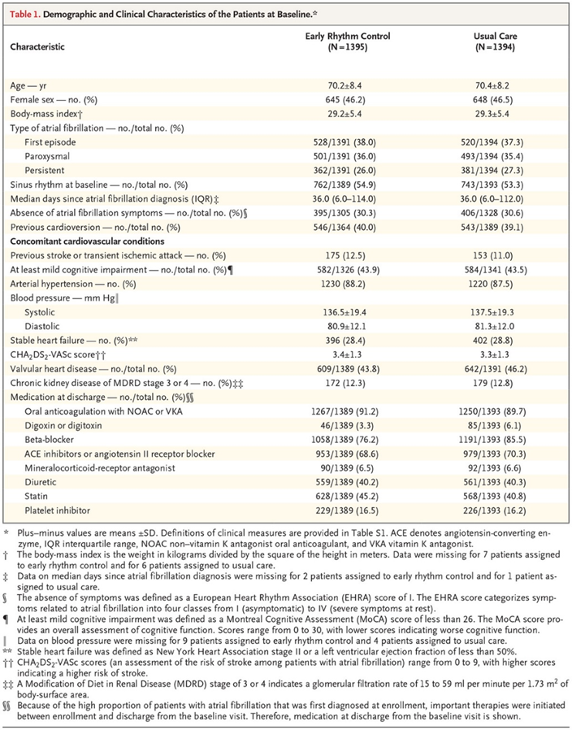
How to make a good table?
Points to be noted:
Title
Alignment
Consistency
No empty cells
Use of headings
Variable definitions
Footnotes
Abbreviations
Source: P Kirchhof et al. N Engl J Med 2020.

Slide 14
Can you tell the difference?
Factors | No infection | Infection
Age in years, mean (SD) | 69.8 (11.2) | 71.9 (12.4)
Female sex, n (%) | 1245 (45) | 321 (48)
Previous infection, n (%) | 205 (7.2) | 32 (10)
Factors | No infection | Infection
Age in years, mean (SD) Female sex, n (%) Previous infection, n (%) | 69.8 (11.2) 1245 (45) 205 (7.2) | 71.9 (12.4) 321 (48) 32 (10)

Slide 15
Can you tell the difference?
Factors | No infection | Infection
Age in years, mean (SD) | 69.8 (11.2) | 71.9 (12.4)
Female sex, n (%) | 1245 (45) | 321 (48)
Previous infection, n (%) | 205 (7.2) | 32 (10)
Factors | No infection | Infection
Age in years, mean (SD) Female sex, n (%) Previous infection, n (%) | 69.8 (11.2) 1245 (45) 205 (7.2) | 71.9 (12.4) 321 (48) 32 (10)

Slide 16
Avoid copy + pasting numbers
Instead use different packages to directly export your results to Excel or Word.
Advantages:
Saves time and effort
Reduces error
Facilitates reproducible research

Slide 17
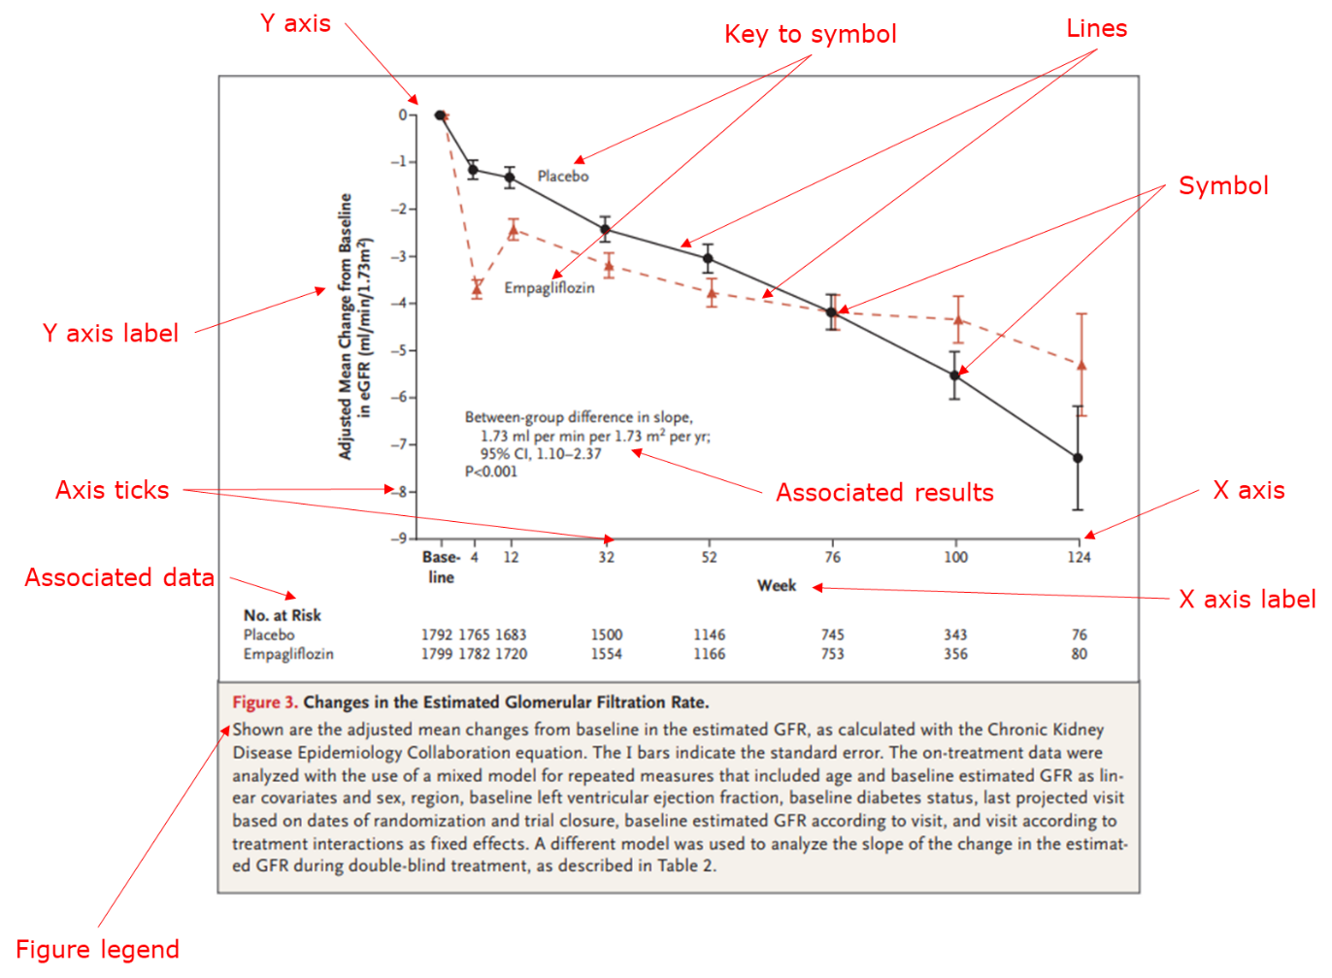
How to make a good figure?
A figure legend may contain:
A brief title
Variable definitions
Definitions of symbols or lines
Explanation of panels (A, B, C, D)
Statistical information (statistical model specification, tests used, p-values)
Brief description of the key findings that are seen in the figure

Slide 18
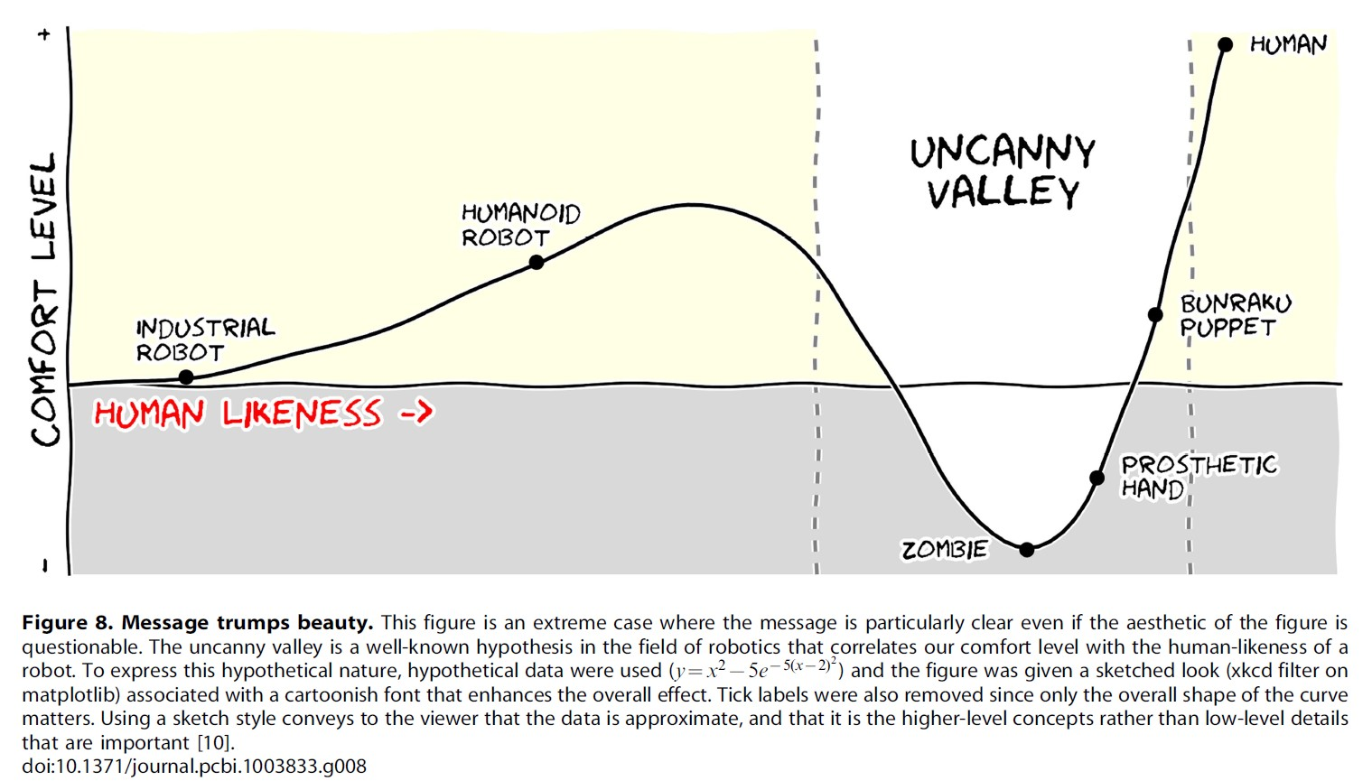
Message trumps beauty

Slide 19
Avoid Chartjunk
“Perfection is achieved not when there is nothing more to add, but when there is nothing left to take away.”
— Antoine de Saint-Exupery.

Slide 20
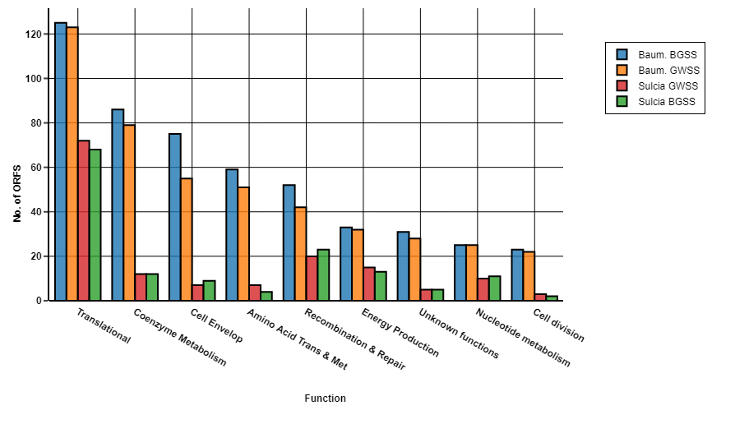
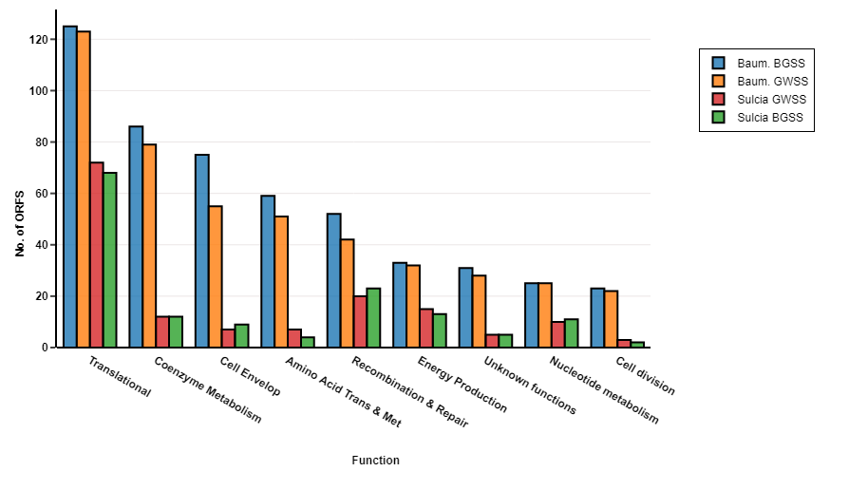
Which graph looks better?

Slide 21

For more tips

Slide 22
DPI requirements by journals
DPI stands for "dots-per-inch"
Many journals ask for figures with having at least 300 dpi
How to check the dpi of an image?

Slide 23

GIMP
Open software
GIMP is the GNU Image Manipulation Program. It is an application for such tasks as photo retouching, image composition, and image authoring.
If you need to quickly retouch an image or add some legends or labels, GIMP is the perfect tool.

Slide 24
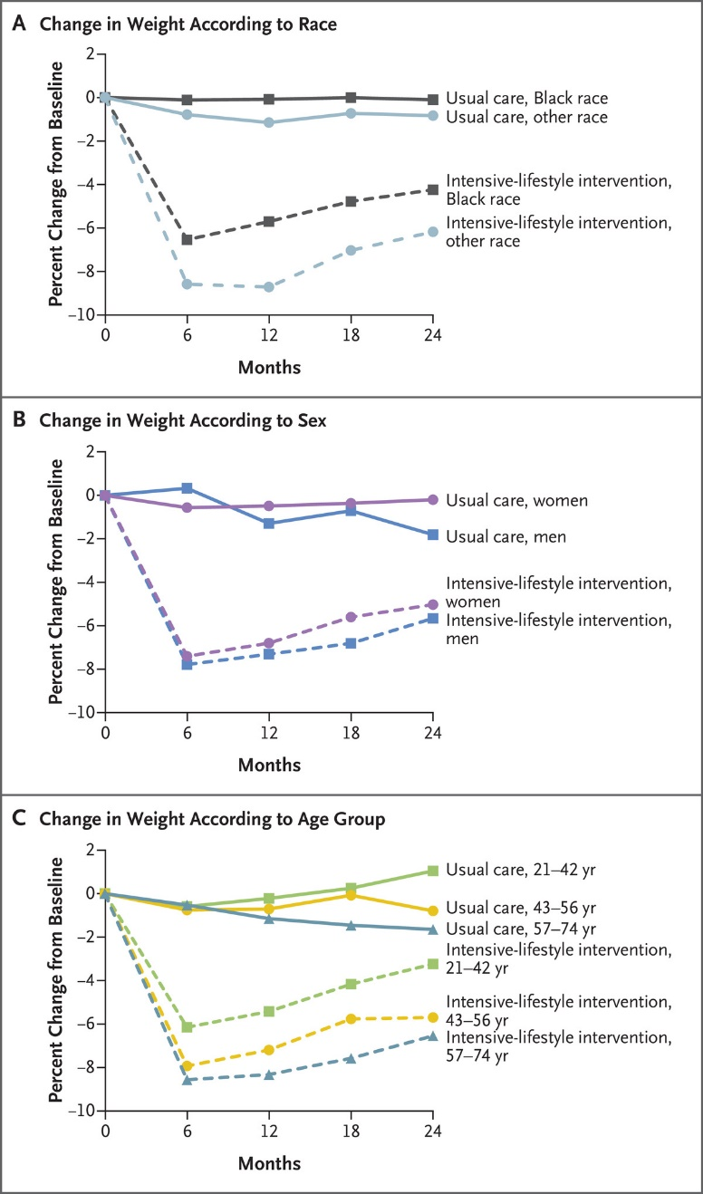
Multi-panel plots
Combining multiple plots or add objects (e.g., image or text) to a single plot
Utilities:
Reduce the number of total figures
Convenience to the readers
Can highlight the comparisons
The legend of a multi-panel figure must identify each graph
When mentioned in the text, specific graph needs to be cited [e.g. Figure 2 (A)]
Source: PT Katzmarzyk et al. N Engl J Med

Slide 25
Creating tables and figures in R
R packages with some exercises are given on the course website
The rules for a good figure or table are independent of the package or statistical programs
Do not trust the defaults
Always refer to the journal guidelines

Slide 26
What are the common measures we get from statistical models?

Slide 27
Common measures we get from statistical models
β – coefficient
P-value
95% confidence intervals
Measures of association:
Odds ratio
Hazard ratio
Rate ratio
Correct interpretation of them is key to the effective presentation of your results.

Slide 28
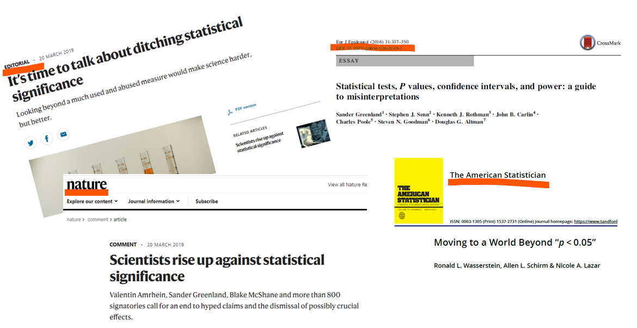
Reporting statistical inference
“When a measure becomes a target, it ceases to be a good measure.”
-Goodhart’s law

Slide 29
Why are the p-values different?
Study 1
Study 2
Male: 68.5 kg
Female: 66.0 kg
Difference: 2.5 kg
P-value: 0.10
Male: 67.2 kg
Female: 62.0 kg
Difference: 5.2 kg
P-value: 0.02
Study 3
Male: 65.2 kg
Female: 62.7 kg
Difference: 2.5 kg
P-value: 0.02

Slide 30
Why are the p-values different?
Study 1
Study 2
Male: 68.5 kg
Female: 66.0 kg
Difference: 2.5 kg
P-value: 0.10
Male: 67.2 kg
Female: 62.0 kg
Difference: 5.2 kg
P-value: 0.02
Study 3
Male: 65.2 kg
Female: 62.7 kg
Difference: 2.5 kg
P-value: 0.02
Sample size: 240
Sample size: 240
Sample size: 980

Slide 31
P-value depends on
Effect size
Precision (Sample size)

Slide 32
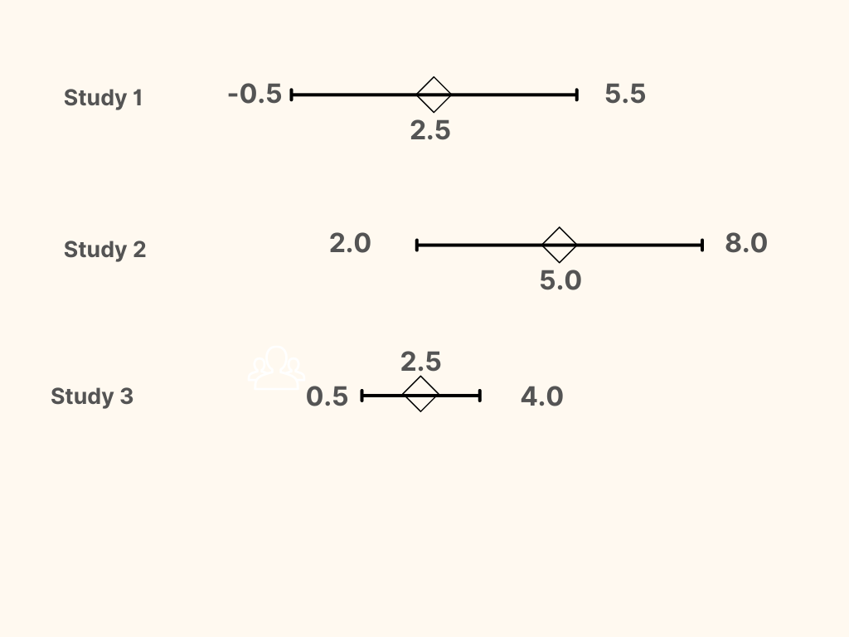
Confidence intervals

Slide 33
A shift from significance testing to estimation
Five Don’ts:
Don’t base your conclusions solely on whether an association or effect was found to be “statistically significant”
Don’t believe that an association or effect exists just because it was statistically significant.
Don’t believe that an association or effect is absent just because it was not statistically significant.
Don’t believe that your p-value gives the probability that chance alone produced the observed association or effect or the probability that your test hypothesis is true.
Don’t conclude anything about scientific or practical importance based on statistical significance (or lack thereof).
Two Dos:
Do use confidence intervals as quantitative measures indicating magnitude of effect size and degree of precision
Do accept uncertainty: P-values, confidence intervals, and other statistical measures are all uncertain.

Slide 34
Interpreting measures of association
Measures of association:
In relative scale:
Relative risk
Incidence rate ratio
Hazard ratio
Odds ratio
In absolute scale:
Risk difference

Slide 35
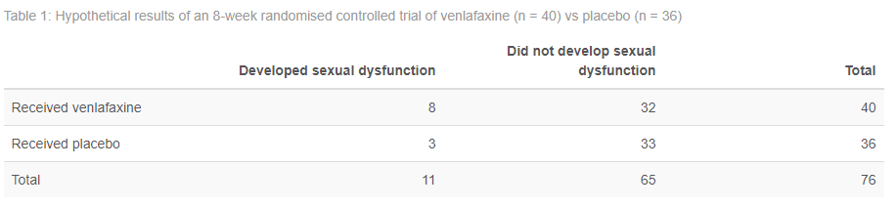
Hypothetical example
The relative risk of sexual dysfunction with venlafaxine vs. placebo is 2.40
The odds ratio of sexual dysfunction with venlafaxine vs. placebo is 2.75

Slide 36
Interpretations of relative risk
Venlafaxine, relative to placebo, is associated with a 2.4-fold risk of sexual dysfunction.
Venlafaxine is associated with a more than doubled risk of sexual dysfunction.
The risk of sexual dysfunction with venlafaxine is 2.4 times that with placebo.
The risk of sexual dysfunction with venlafaxine is 240% that with placebo.
Compared with placebo, venlafaxine is associated with a 1.4-fold increased risk of sexual dysfunction.
Compared with placebo, venlafaxine is associated with a 140% increased risk of sexual dysfunction.

Slide 37
Interpretations of odds ratio
The communications for odds ratios are not as intuitive as relative risks, particularly because odds are not an easy-to-understand concept like probabilities.
The odds of developing sexual dysfunction with venlafaxine (relative to placebo) are 2.75 to 1.
The odds of developing sexual dysfunction with venlafaxine are 2.75 as large compared with placebo.
There is a 175% increase in odds of developing sexual dysfunction with venlafaxine when compared with odds of developing sexual dysfunction with placebo.
Translation of an odds ratio of X to an “X-fold risk,” is seen commonly in published papers. This is wrong because odds ratios are based on a different underlying concept than relative risks.

Slide 38
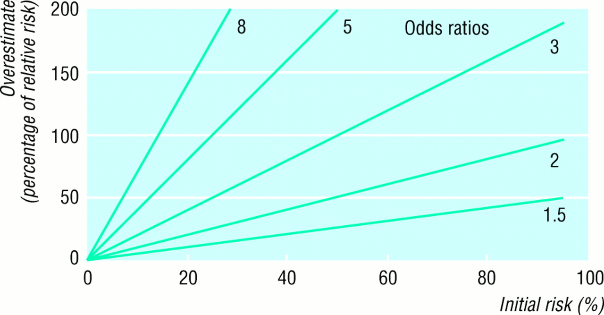
Are odds ratio and relative risk equivalent?
Rare disease assumption
When an event occurs more commonly, the odds ratios always overstate any effect size whereas relative risks remain constant.
It is also important to remember that because of the mathematical behaviour of the odds ratio, estimates of the odds ratio may vary among studies of differing designs, even if the actual risk ratio is constant.
Source: Davies BMJ 1998; 316

Slide 39
Association vs. causation
Our goal is to find causation
Reality (confounding, measurement errors, study design) stops us
We settle for association
Confounders
Coffee drinking
Skin cancer

Slide 40
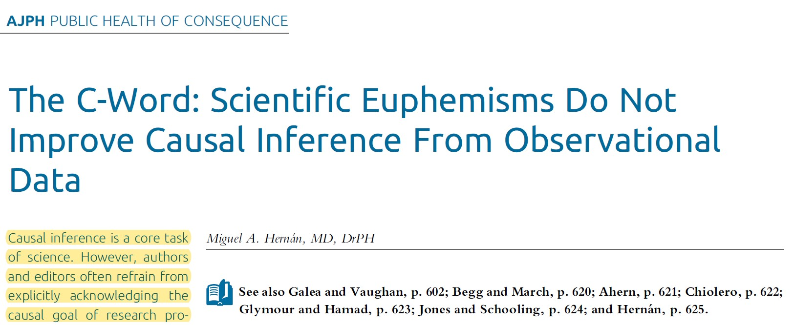
Should we avoid causal language altogether?
Miguel Hernán argued that
we need to use causal language to accurately describe the aims of our research
the term “causal effect” can be appropriate
in the title and Introduction section of our article when describing the aim of our research
in the Methods section when describing which causal effect we are trying to estimate through an association measure
in the Discussion section when providing arguments for and against the causal interpretation of our association measure.
The only part of the article in which the term “causal effect” has no place is the Results section, which should present the findings without trying to interpret them.

Slide 41
Guidelines for reporting model results
Mostly dependent on the study design and nature of the data
The Strengthening the Reporting of Observational Studies in Epidemiology (STROBE) Statement: guidelines for reporting observational studies
The REporting of studies Conducted using Observational Routinely-collected health Data (RECORD) Statement

Slide 42


